Slide 1
HELLO!
====Group Members====
1.Malav Vora(20BEIT30139)
2.Manav Patel(20BEIT30082)
3. Khush Patel(20BECE30051)

Slide 2
Smart Attendance System

Slide 3
Preface
Abstract
Introduction
About QR Recognition
Modules and Algorithm
Advantages
Diagrams
Screenshots
Conclusion

Slide 4
Abstract
The project is a system that takes down student's attendance using QR Code.
We provide an unique QR code to the student.
Each QR code represents a unique id of students.
Students just have to scan their QR code using scanner and the system notes down their attendance as per dates and time.
System then stores all the student's attendance records and generates defaulter list.

Slide 5
Introduction
Nowadays, taking attendance manually by using paper and pen was one approach we used even we knew the process seems slow and unproductive.
This growth in electronic transactions results in great demand for fast and accurate user identification and authentication.
1
1

Slide 6
Introduction
In this project, we propose a system that takes the attendance of student for classroom lecture. Our system takes the attendance automatically using QR recognition.
This system is a web based system under the supervision of lecturers to generate the QR Code and to collect data of the attendance.
1
1

Slide 7
Problem Statement
Record of students attendance are done manually by using attendance sheet during class session.
The attendance sheet could be lost.
To overcome this problem, we came up with the technology called QR based smart attendance system.

Slide 8
Objectives
To design an efficient computerized attendance system to be used for lecturers, students.
To implement the system to facilitate the lecturers managing student's attendance.

Slide 9
Expected Result
The system able to manage student attendance record efficiently.
The system able to facilitate lecturers to collect data and information.
The system notifies the attendance record for parents effectively.

Slide 10
QR Recognition?

Slide 11
QR Recognition
QR code is Known as the Quick Response code.
Quick Response Code, is a two dimensional code used to record thousands of characters and numbers in a small image created.
1
1

Slide 12
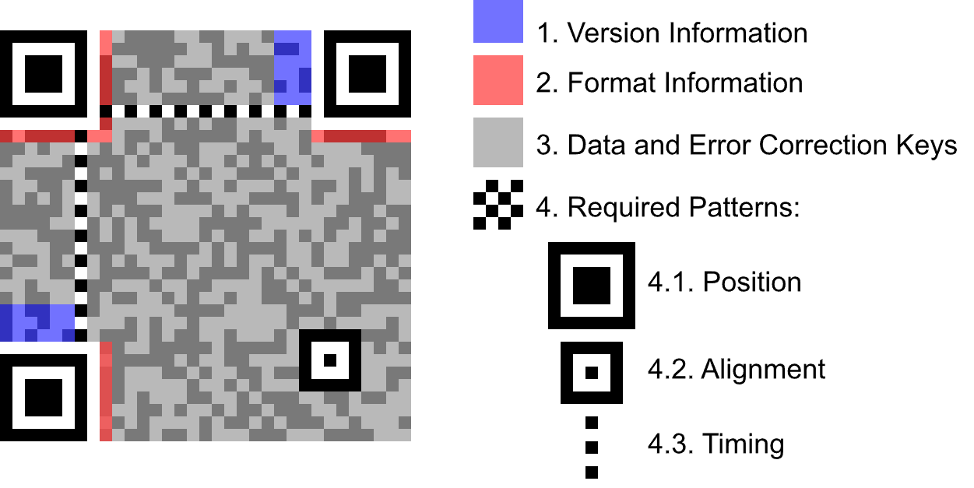
Version Information- it is directly connected with their dimensions and the amount of data which should be encoded.
Format Information-helps the scanning device to define the data format, encoded in the QR code.
Data and error correction keys-It has a capability to remain scannable even if it damaged.
Alignment patterns-allow the scanning device to define the possible perspective distortion of the QR code image

Slide 13
Modules and Algorithm
We have used:-
Tkinter
MyQR
Pyzbar
OS
Opencv

Slide 14
Advantages
Quick and more accurate attendance records.
Data is collected and stored automatically.
No need to maintain attendance sheet as the attendance are electronically stored in database.
It saves time ,cost, efforts and organization resources.
1
1

Slide 15
Diagrams

Slide 16
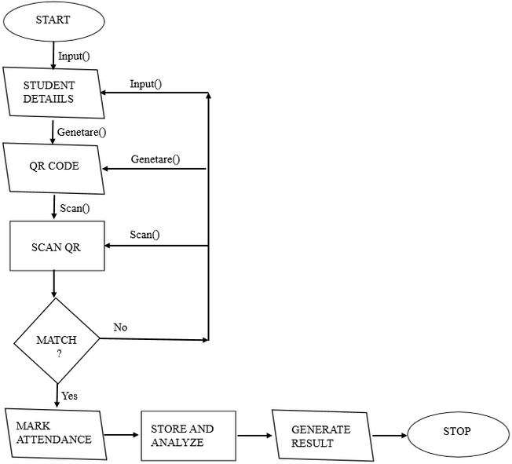
Flow Chart

Slide 17
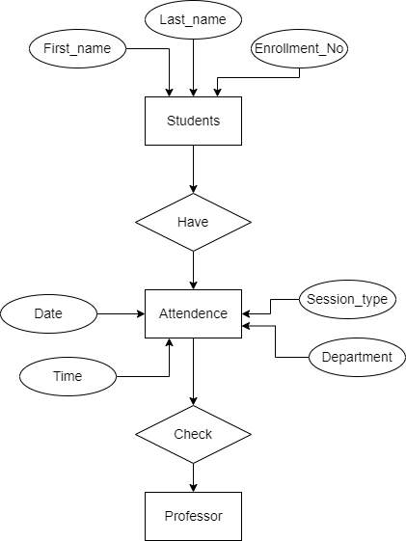
E-R Diagram

Slide 18
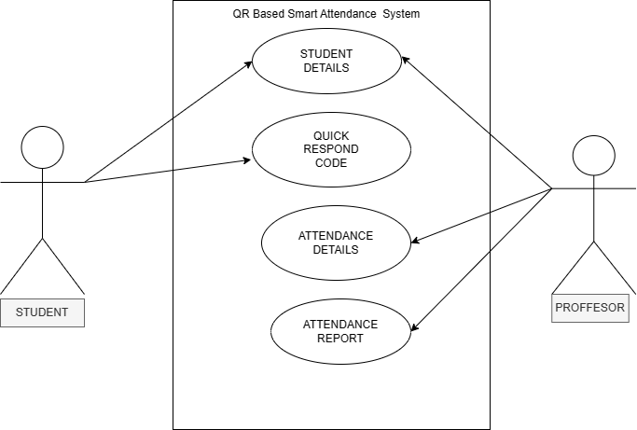
Use Case Diagram

Slide 19
Screenshots

Slide 20
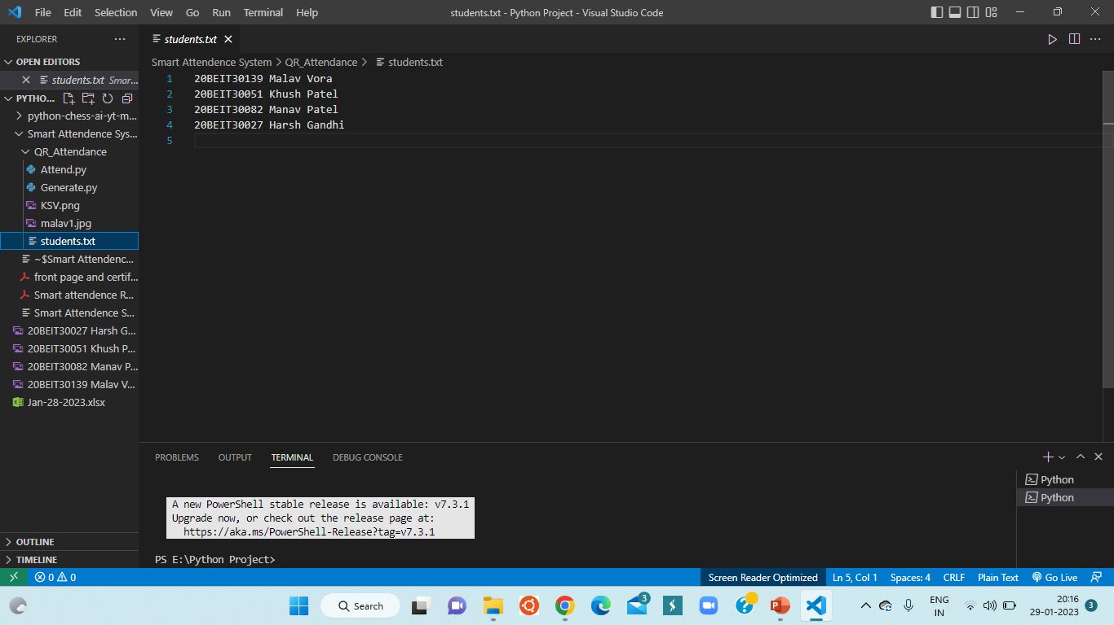

Slide 21
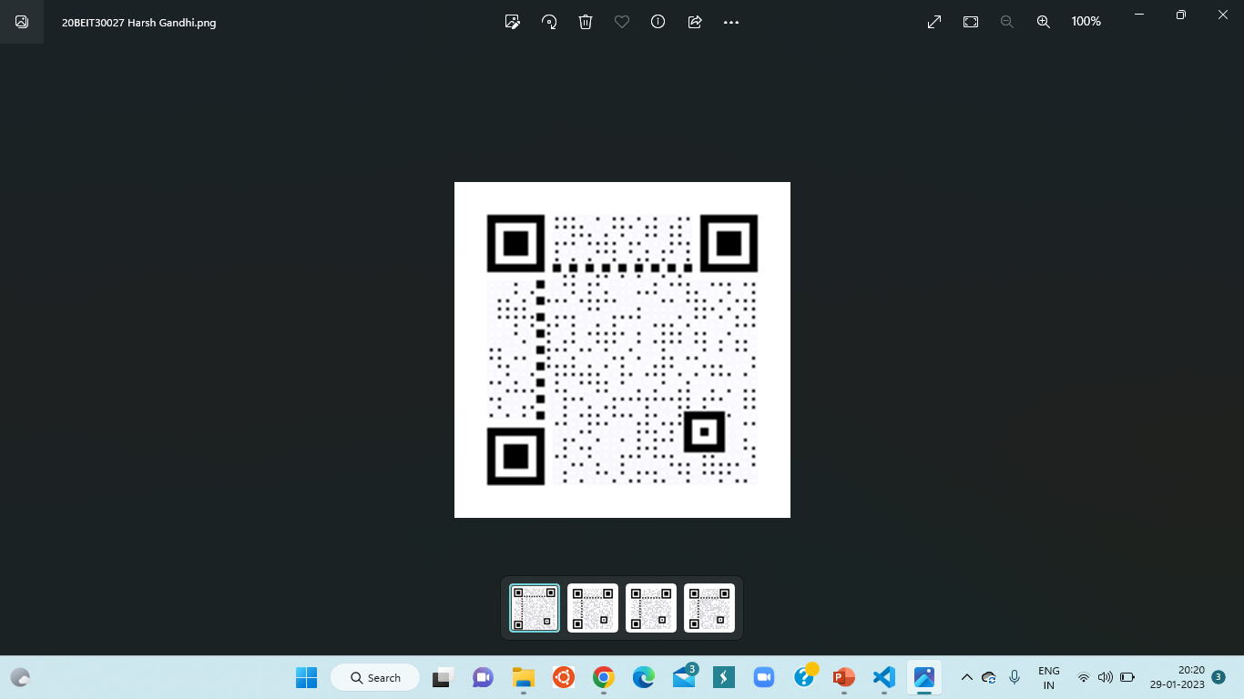

Slide 22
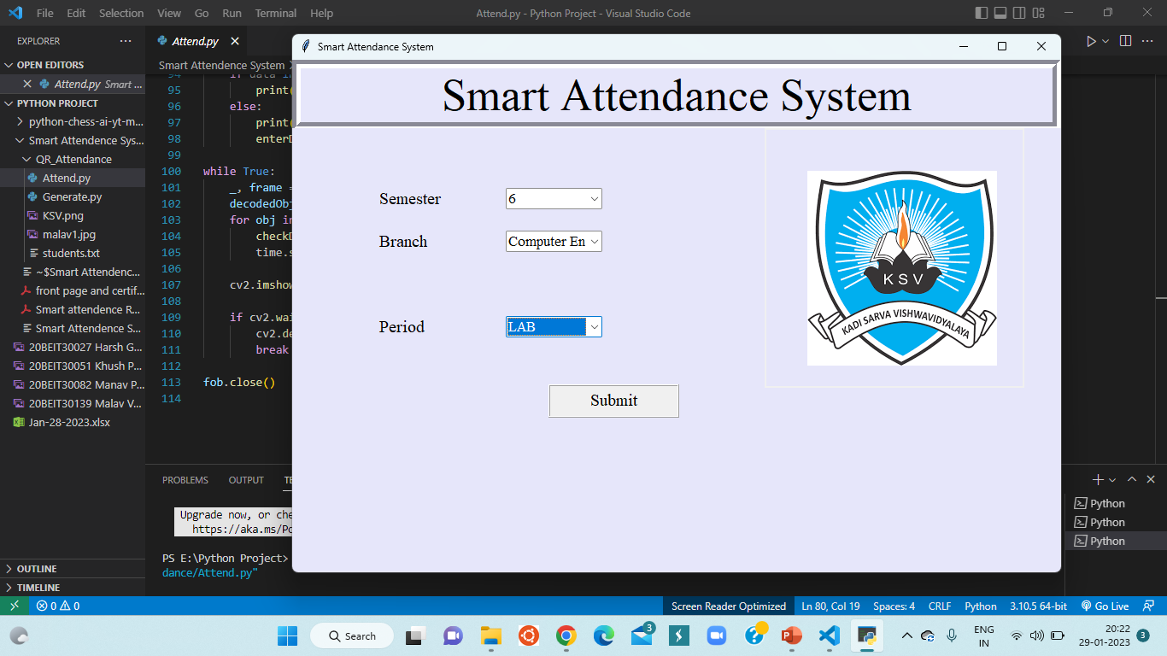

Slide 23
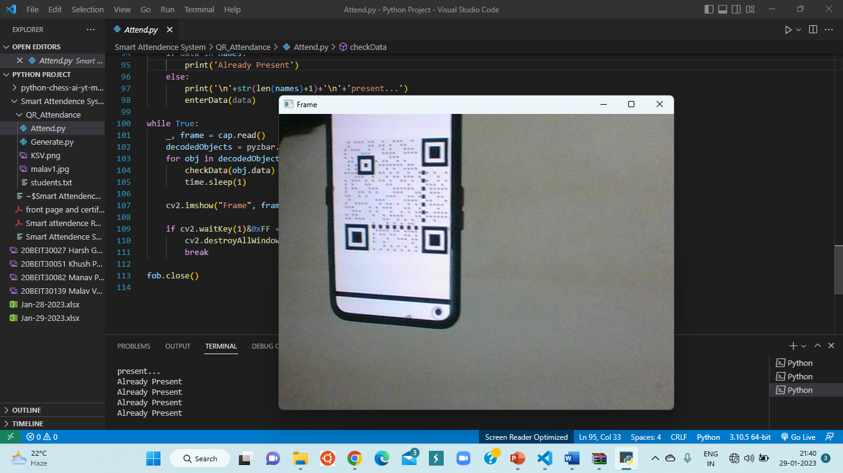

Slide 24
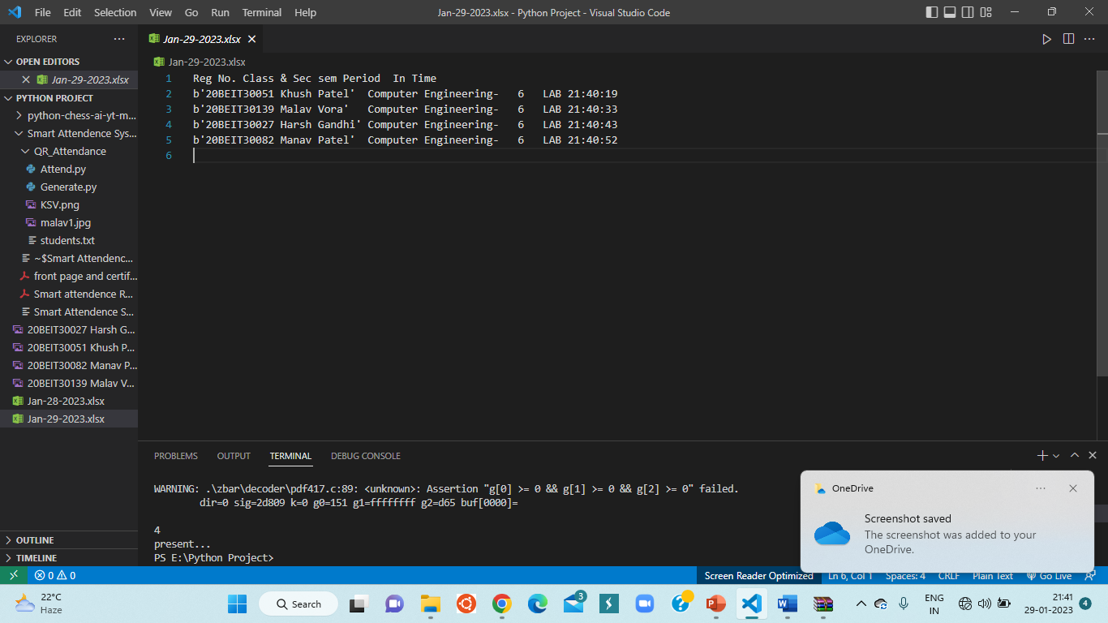

Slide 25
Conclusion

Slide 26
Conclusion
QR Code Based Smart Attendance System is the most accurate.
It is an efficient method to store the attendance in the smart phone rather than wasting the paper.

Slide 27
THANKS!
Any questions?
You can find us at:
malavvora5@gmail.com
khush9445@gmail.com
manavptl2124@gmail.com

